Slide 1

Vehicle Routing Problem: Wisdom of Crowds using Genetic Algorithms
Jacob Taylor Cassady

Slide 2
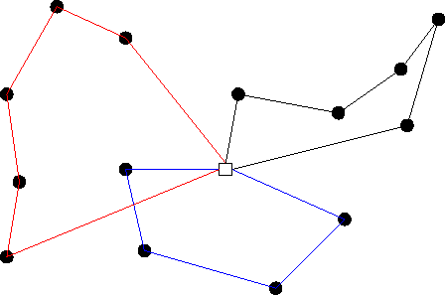
The Vehicle Routing Problem
First presented by George Dantzig and John Ramser in their 1959 publication, “The Truck Dispatch Problem”
A generalization of the Traveling Salesman Problem:
There can be one more depots that serve a number of customers
Each depot has one or more vehicles
The Goal is to minimize the distance traveled across all routes.

Slide 3
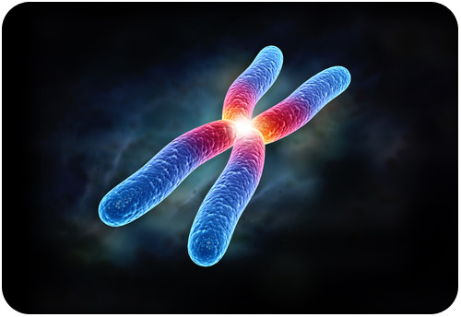
Approach – Genetic Algorithms
licensed under CC BY-SA-NC
A population of chromosomes for the genetic algorithm were formulated as a list of depots represented as vertices with a list of customers, also represented as vertices.
Chromosome fitness is calculated as the total distance traveled across all depot’s route.
3 Depots, 8 Customers per Depot
1
6
9
1
1
customers
Depot
Route: 1,3,5,2,9,7,6,8,4,1
Route: 6,3,5,2,9,7,1,8,4,6
Route: 9,3,5,2,1,7,6,8,4,9
Chromosome Fitness= sum(Distance Traveled Per Route)

Slide 4






Approach – Genetic Algorithms
Vehicles were integrated into the formulation by redefining the fitness function.
3 Depots, 8 Customers per Depot, 2 vehicles per depot
1
6
9
1
1
Depot
Route: 1,3,5,2,9,1
+ 1,7,6,8,4,1
Route: 6,3,5,2,9,6
+ 6,7,1,8,4,6
Route: 9,3,5,2,1,9
+ 9,7,6,8,4,9
Chromosome Fitness= sum(Distance Traveled Per Route)

Slide 5
Approach – Genetic Algorithms
An advance in the genetic algorithm’s generation was defined as a sequence of crossover and mutation.
These methods act on each route’s customers separately agnostic of vehicle boundary lines.
1
6
9
4
9
2
5
1
1
1
6
9
1
1

Slide 6

Approach – Crossover Methods
Uniform
Child is formed by randomly alternating alleles between the two parents.
Partially-Mapped Crossover (PMX)
The parents are broken up into three sections of random length. The sequences S1 and S3 from parent 1 are copied to the child. S2 is formed by starting from S2 in parent 2 and leaping over genes that are already established.
Ordered Crossover
The parents are broken up into three sections of random length. The sequence S1 from parent 1 and S3 from parent 2 are copied to the child. S2 is formed with the remaining alleles from parent 1.
1
4
9
2
5

Slide 7

Approach – Genetic Algorithms
An advance in the genetic algorithm’s generation was defined as a sequence of crossover and mutation.
These methods act on each route’s customers separately agnostic of vehicle boundary lines.
1
6
9
4
9
2
5
1
1

Slide 8
Approach – Mutation Methods
Reverse Sequence Mutation (RSM)
TWORS Mutation
Randomly swap two alleles
1
1
4
5
4
8
6
7
9
2
5
3
9
2
4
9
2
5
1
1
4
9
2
5
4
9
2
5
8
5

Slide 9

Approach – Wisdom of Crowds
A crowd was created from combinations of every implemented crossover and mutation methods.
Each genetic algorithm in the crowd shared:
population size
mutation probabilities
crossover probabilities
epoch thresholds
UNIFORM_TWORS
PM_TWORS
ORDERED_TWORS
UNIFORM_RSM
PM_RMS
ORDERED_RMS

Slide 10

Approach – Wisdom of Crowds
Each algorithm ran agnostic of each other as a separate thread. Once all threads were completed, a predetermined set of weights was used to choose more of the best performing chromosomes from algorithms that historically performed better.
ORDERED_TWORS
Crossover | Mutation | Crowd Weight
Uniform | RSM | 0.05
Uniform | TWORS | 0.05
PM | RSM | 0.05
PM | TWORS | 0.05
ORDERED_RSM | RSM | 0.6
ORDERED_TWORS | TWORS | 0.2
UNIFORM_TWORS
PM_TWORS
UNIFORM_RSM
PM_RMS
ORDERED_RMS

Slide 11
Approach – Wisdom of Crowds
Aggregation of the chromosome’s solutions was done by surveying the adjacencies, or edges, of each allele.
The edges that occurred at least 3/10ths as frequent as the most frequent occurring edge were used in the final solution. This threshold value was referred to as the superiority threshold.
If two or more edges were in the final solution with similar allele starting or end points, the edge with the highest frequency was chosen. If the frequencies were equal, the shortest edge was chosen.
Remaining unvisited vertices were chosen by selecting the closest unvisited vertex in distance to any vehicles route belonging to the same depot.

Slide 12
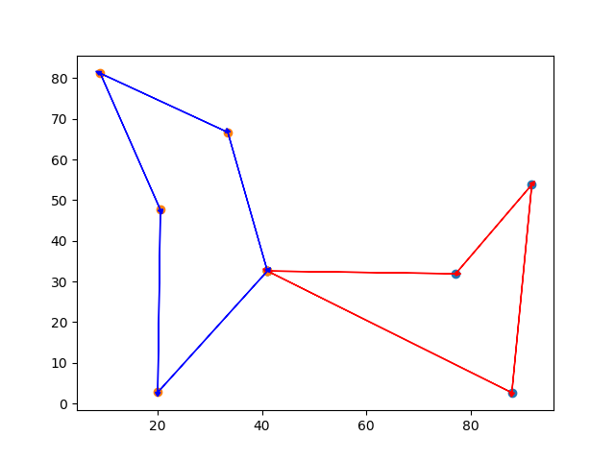
Results

Slide 13
Survey of 20 Tests (1 Depot, 20 Customers)
ALGORITHM | average result | average runtime | average comparison | tests better than average | Tests Surveyed | Percent Superior to Avg
GA_UNIFORM_TWORS | 860.48 | 0.99 | 10.92 | 10 | 20 | 50%
GA_UNIFORM_RSM | 874.73 | 1.02 | 25.17 | 4 | 20 | 20%
GA_PM_TWORS | 871.60 | 1.00 | 22.03 | 6 | 20 | 30%
GA_PM_RSM | 874.50 | 1.10 | 24.94 | 5 | 20 | 25%
GA_ORDERED_TWORS | 862.47 | 1.18 | 12.90 | 8 | 20 | 40%
GA_ORDERED_RSM | 866.80 | 1.00 | 17.23 | 5 | 20 | 25%
WisdomOfCrowds_GA | 736.37 | 6.73 | -113.20 | 19 | 20 | 95%
AVERAGE_FOR_ALGORITHMS | 849.56 | 1.86 | 0 | - | - | -

Slide 14
Survey of 20 Tests (19 Depots, 20 Customers)
ALGORITHM | average result | average runtime | average comparison | tests better than average | Tests Surveyed | Percent Superior to Avg
GA_UNIFORM_TWORS | 16541.17 | 19.32 | 378.99 | 0 | 20 | 0%
GA_UNIFORM_RSM | 16438.16 | 19.63 | 275.97 | 1 | 20 | 5%
GA_PM_TWORS | 16520.75 | 19.43 | 358.56 | 0 | 20 | 0%
GA_PM_RSM | 16496.21 | 18.64 | 334.03 | 0 | 20 | 0%
GA_ORDERED_TWORS | 16431.53 | 19.41 | 269.35 | 2 | 20 | 10%
GA_ORDERED_RSM | 16454.62 | 19.28 | 292.44 | 2 | 20 | 10%
WisdomOfCrowds_GA | 14252.86 | 118.25 | -1909.33 | 20 | 20 | 100%
AVERAGE_FOR_ALGORITHMS | 16162.19 | 33.42 | 0 | - | - | -

Slide 15
Findings
The Wisdom of Crowds solution performed better than the average of the genetic algorithms 97.5% of the time in tests surveyed.
Increasing epoch threshold, population size, crossover probability, or mutation probability improves each genetic algorithm’s result at the cost of high runtime.
A lower superiority threshold yields a more optimal crowd solution at the cost of higher overhead during recombination.

Slide 16
Future Work
Run same tests with brute force solution to better understand how optimal the produced WOC solution is.
Implement a larger range of crossover methods and mutation methods from publications on genetic algorithms where order matters.
Isolate optimal hyperparameters through datamining a large number of tests.

Slide 17

Questions?

Slide 18
References
ABDOUN, O., & ABOUCHABAKA, J. (2011, October). A Comparative Study of Adaptive Crossover Operators for Genetic Algorithms to Resolve the Traveling Salesman Problem. International Journal of Computer Applications, 31(11). Retrieved from https://arxiv.org/ftp/arxiv/papers/1203/1203.3097.pdf
Baraglia, R., Hidalgo, J. I., & Perego, R. (2001, December). A Hybrid Heuristic for the Traveling Salesman Problem. IEEE TRANSACTIONS ON EVOLUTIONARY COMPUTATION, 5(6), 613-622. doi:10.1109/4235.974843
Yi , S. M., Steyvers , M., Lee, M. D., & Dry , M. J. (2011). Wisdom of the Crowds in Traveling Salesman Problems.
The Truck Dispatch Problem - https://andresjaquep.files.wordpress.com/2008/10/2627477-clasico-dantzig.pdf
Wikipedia, Traveling Salesman Problem - https://en.wikipedia.org/wiki/Travelling_salesman_problem#History
Wikipedia, Vehicle Routing Problem - https://en.wikipedia.org/wiki/Vehicle_routing_problem

